Slide 1







Slide 2
wicked problem

Slide 3
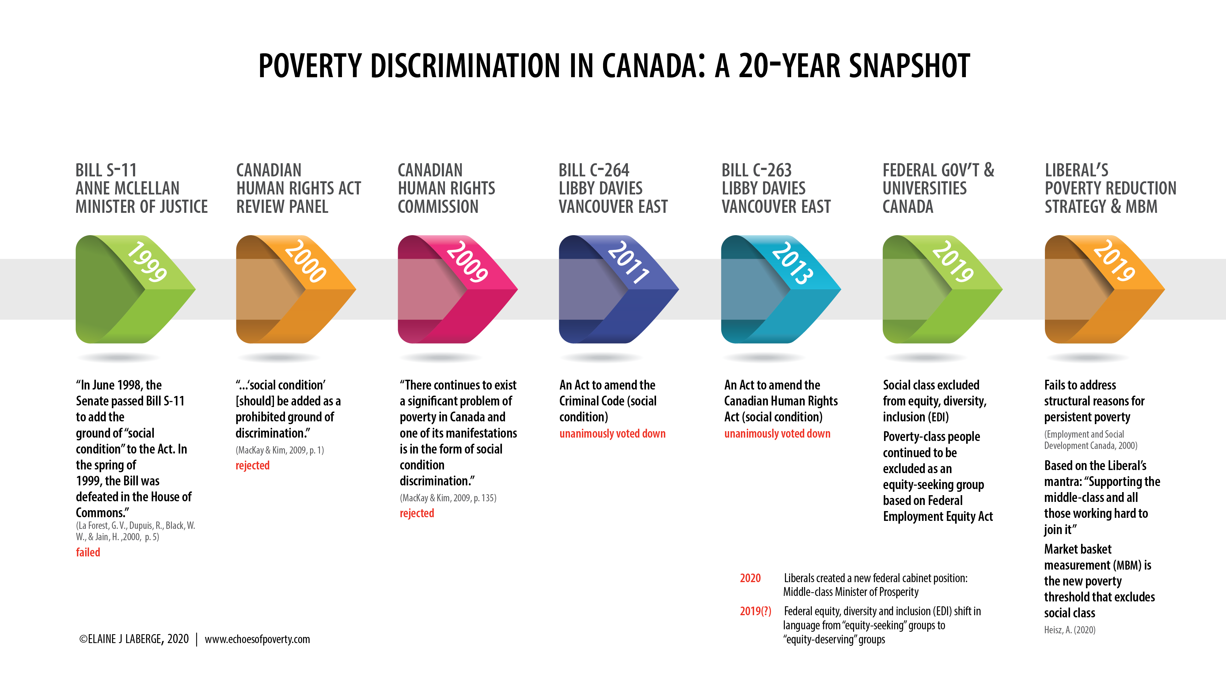

Slide 4
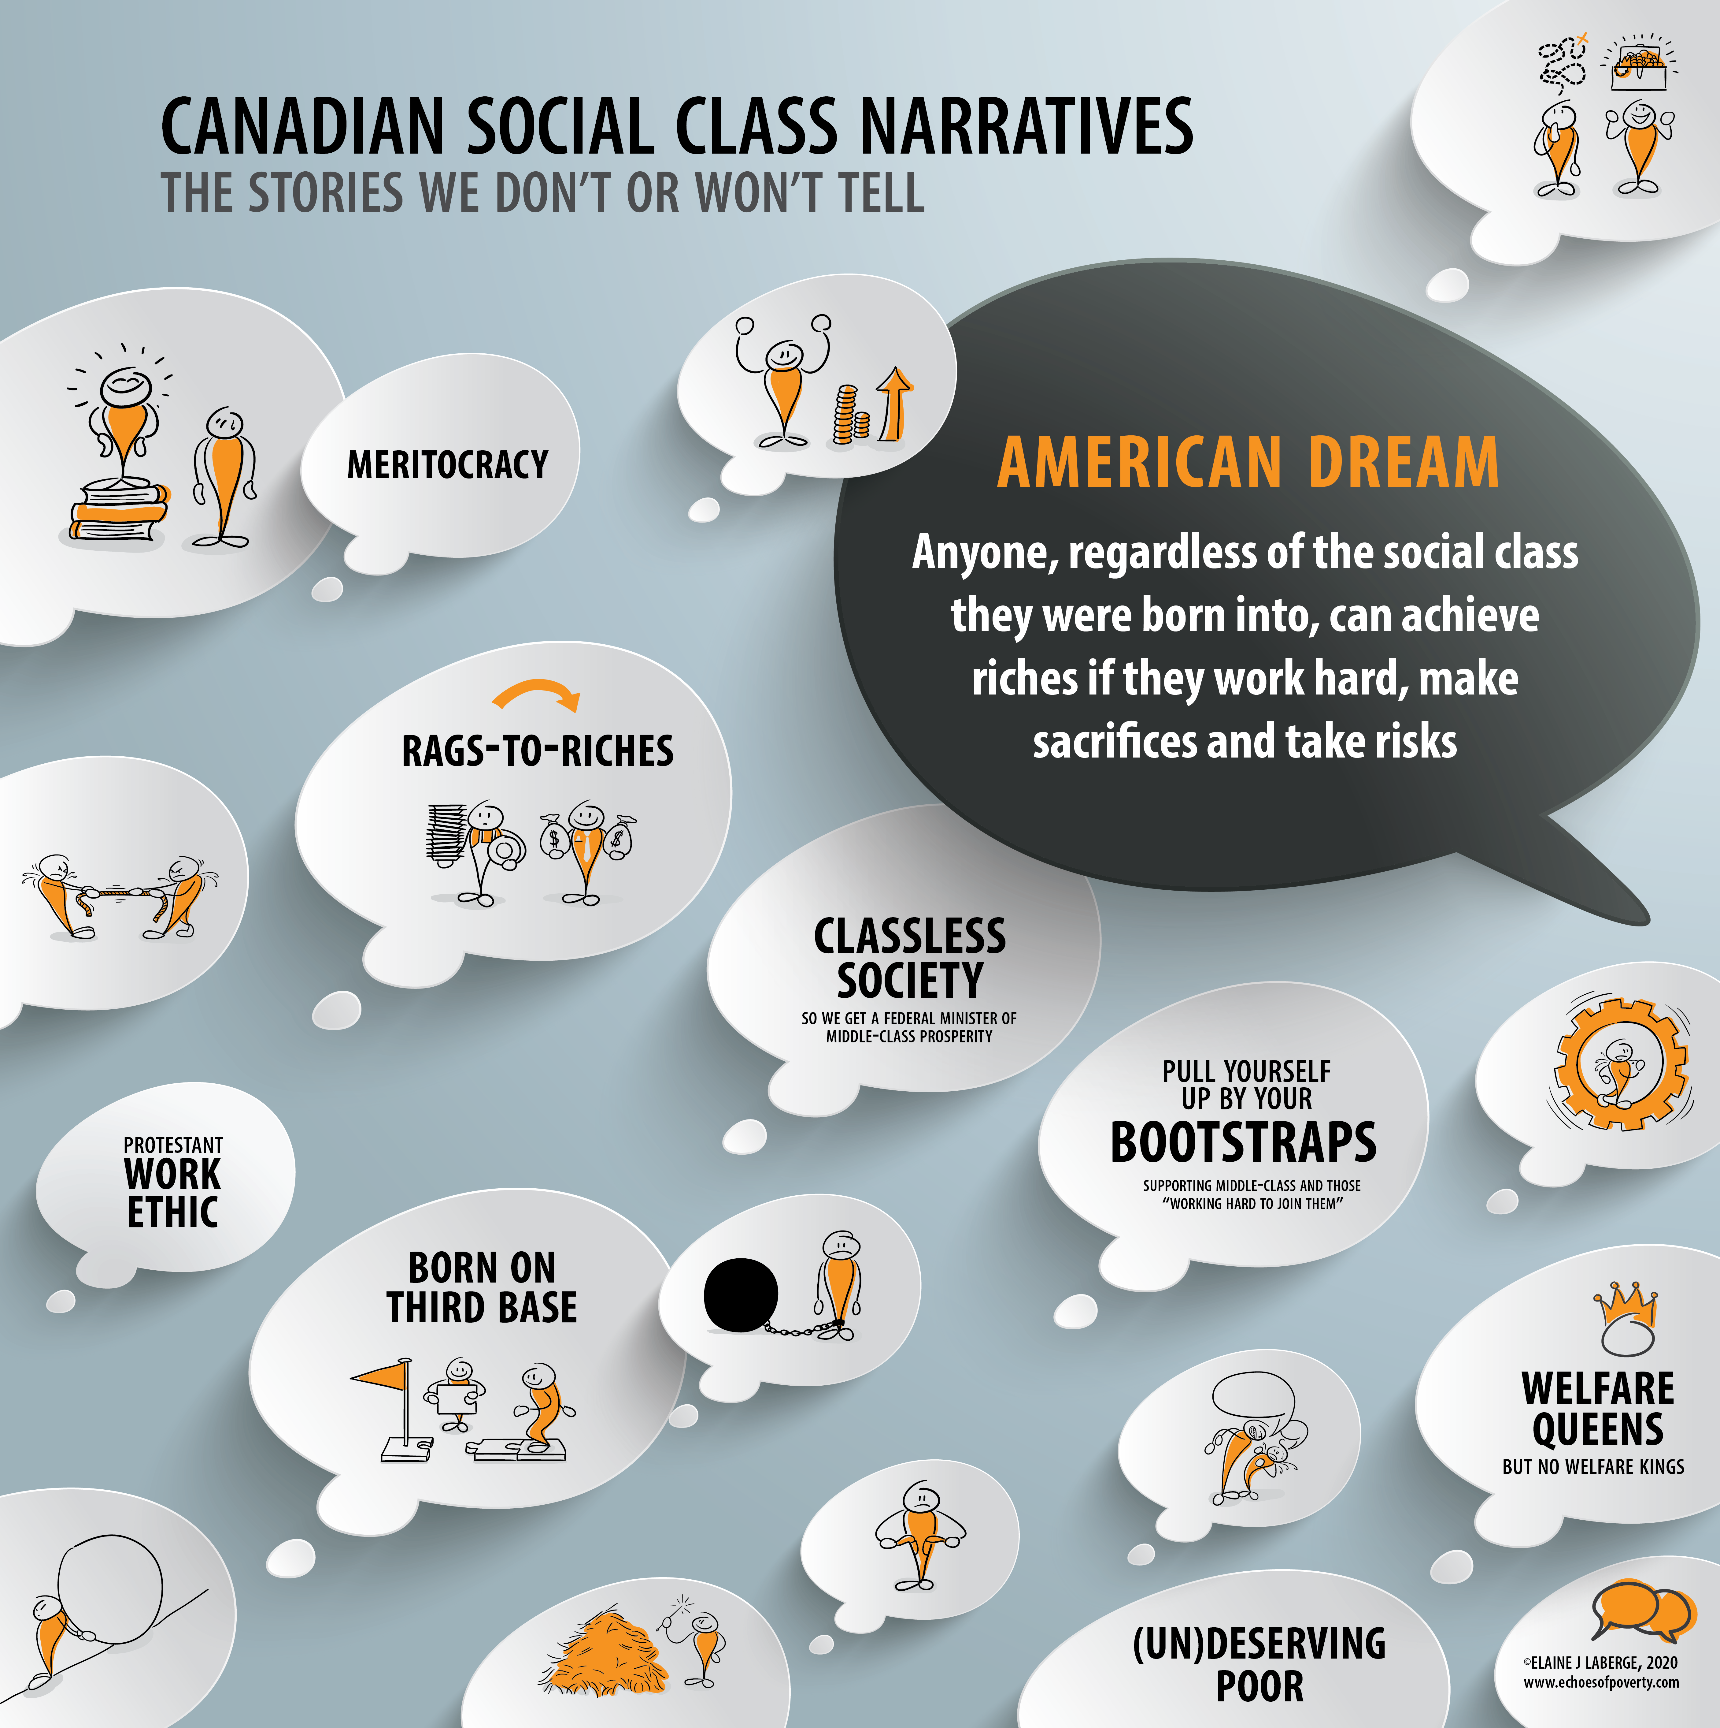

Slide 5
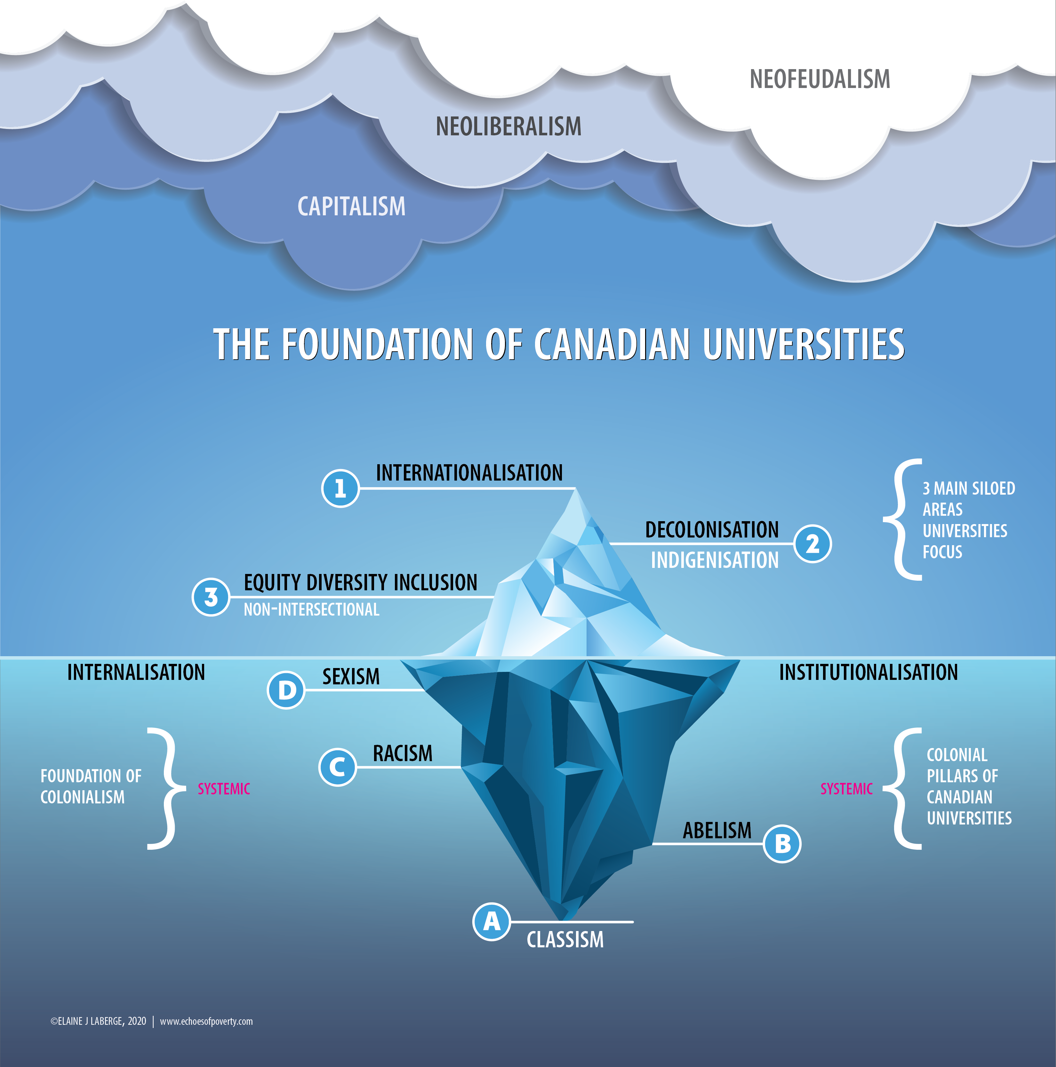

Slide 6
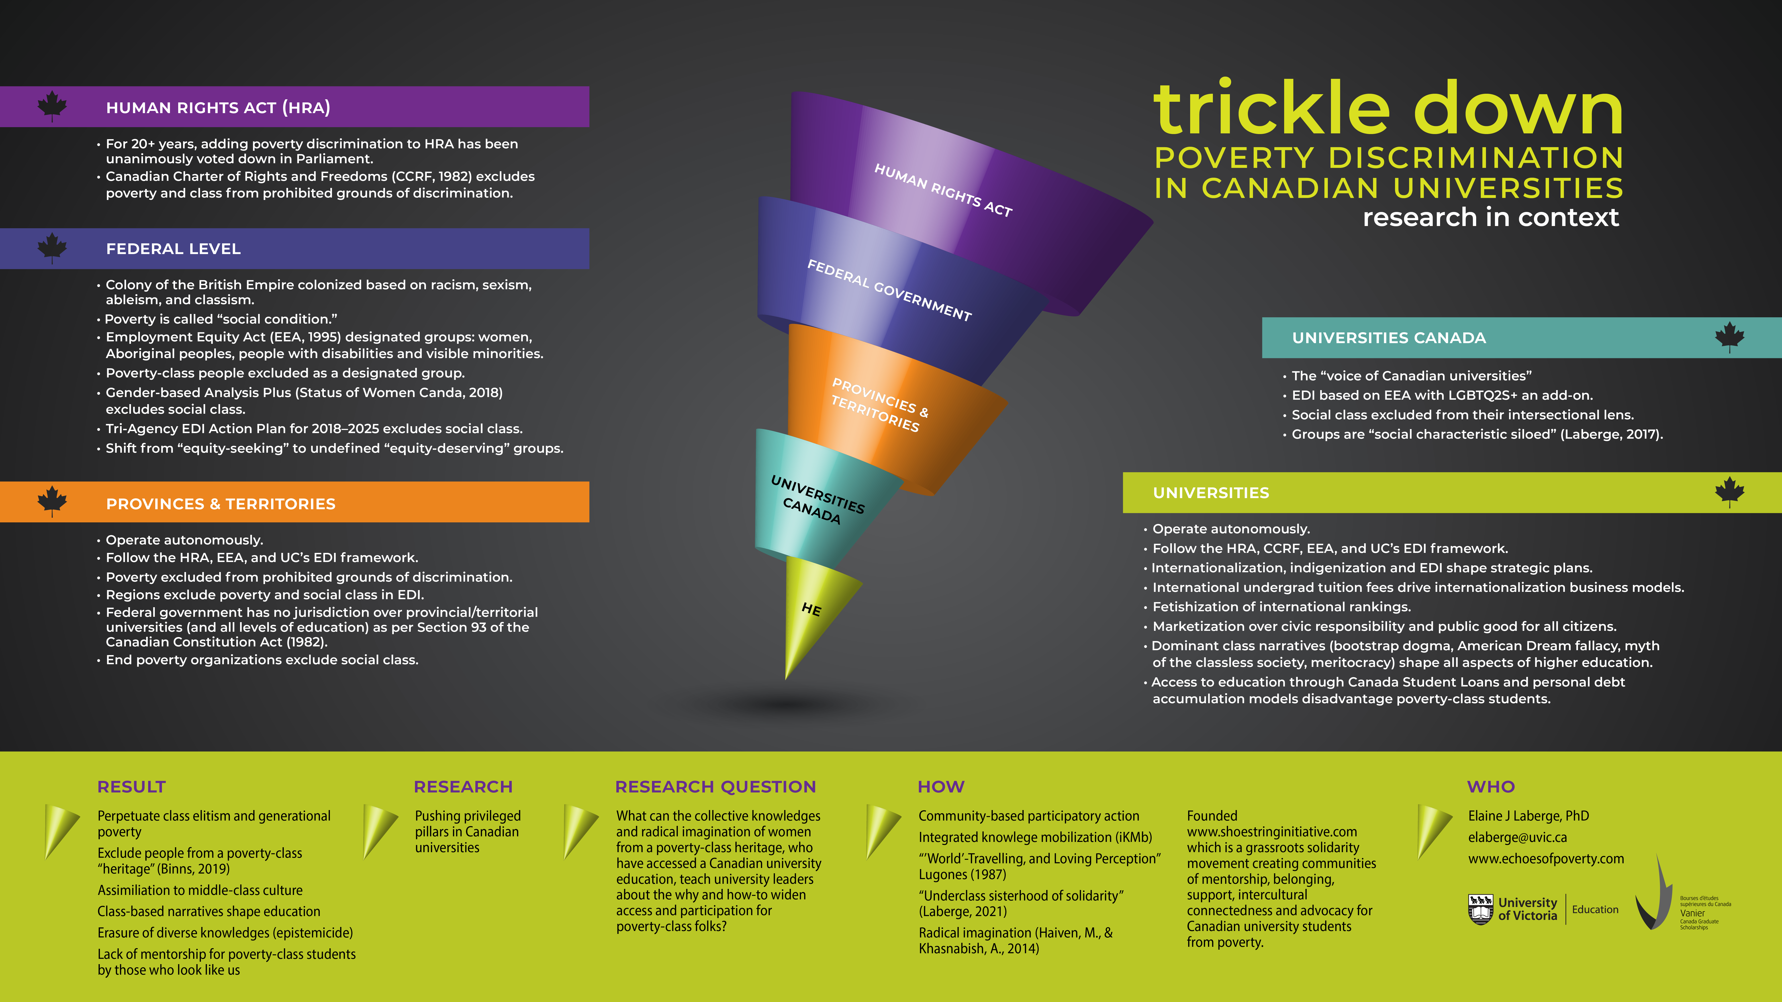

Slide 7
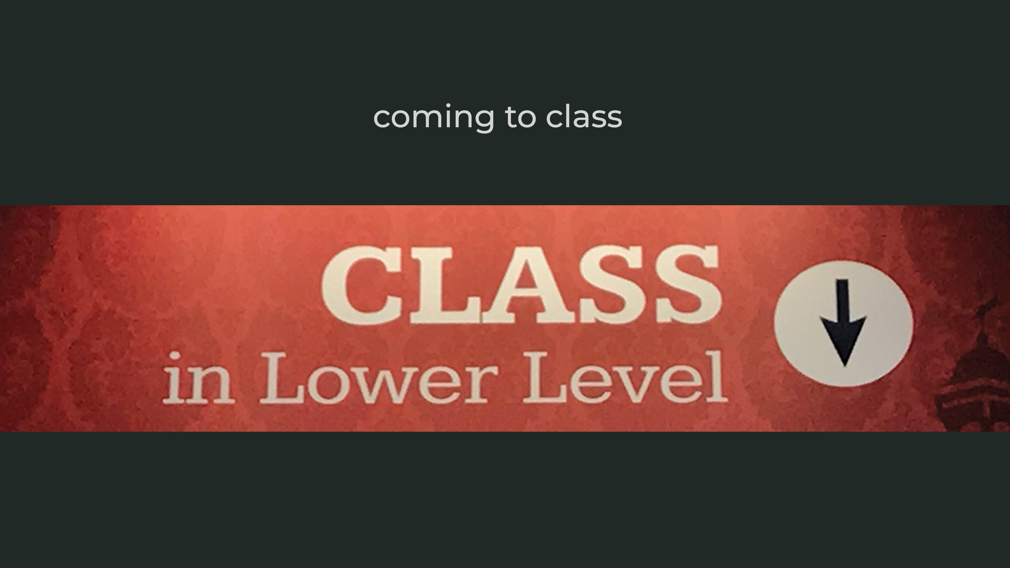
Notes:
This story doesn’t begin with me or end with me. It doesn’t begin with the research Sisters individually or collectively. Our individual and collective stories began long before we entered onto uni landscapes
Our stories start with our families and our ancestors.
For many of us, our stories are shaped by generations born into poverty.
Stories of fleeing persecution. Stories of feeling violence. Stories of being forced into poverty. Stories of the intersection of multiple axes of oppression, marginalization and exclusion.
But ours are also stories of love, caring and community.
Our stories speak to the ancestral and kinship knowledge passed along to us and that shape our lived experiences and how we approached this research with wonders and hopes that things can be otherwise for PCS in Canadian universities
_______________
I remember cleaning a house in part of fund finishing my first undergrad degree
Dame Shirley Bassye’s “History Repeating” was playing and I wondered if my life would be like the women who came before me: deeply entrenched and shaped by generational poverty
These were the days when I was exploring playwrighting and creative non-fiction
I began to see how lives were being lived because of massive poor-rich divides
But I didn’t know about sociology and social class
It was sitting in an undergrad sociology theory class where students who professed to be rich because of their parent’s wealth made fun of poor white people calling them white trash. Students laughed. The instructors nervously laughed. I sat petrified and deeply shamed. In this moment I came to class consciousness. In this moment I came ever so close to walking out the door, out of the university and not looking back. I wanted the ground to swallow me up but I couldn’t really see the cracks in the foundation of Canadian universities
I was in an intro do soc of gender class where the instructor threatened via email to have me kicked out of university because I didn’t have the requisite elitist university cultural knowledge
It was in a sociology of art class with Dr. Richard Westerman at the university of Alberta where I learned that there were profs who looked like me. He was so aware of how class was playing out in class as I sat in my identifiable work uniform. His awareness and support were a game changer. There was something wrong in Canadian universities and I was coming to this awareness
Yes, in Canada, class is always in the lower level of universities. So deep down it is rarely visible to those who don’t need to worry about class
It was Dr. Janice Huber also at the University of Alberta who created space for me to explore social class and poverty discrimination in Canadian universities. Oh, how many conversations we had that shape every step I took and take.
Janice and Richard never asked me to perform poverty porn—the fetishization of poverty
There were also those who resisted my coming to class awareness and how being born into generational poverty shapes my lived experiences, research and understandings of classism in Canadian universities. I learned and learn from these folks, too
When my mother was in palliative care, I learned how she was denied an education by the Alberta government and social workers because of being born into poverty and put in a violent foster care “home.” This echoes across my life and how I understood higher education—university was never for the likes of folks like us. And I’ll admit that I didn’t even know university existed
But the idea of university took root when a male boss told me that 1) I would never make as much as a man in the organization and 2) I would always be living below the poverty line because I didn’t have a university degree. Never mind that my contributions were central to the success of the association. But university dogged me because I lacked class consciousness and the ability to understand the gendered nature of poverty.
I didn’t know terms like first gen, low income or disadvantaged SES students
It would take 15 fragmented years to get this first undergrad degree finished complete with backbreaking student loans
But I persisted but only with the support of professors who were willing to engage in my early forays into unpacking the poverty discrimination I saw and experienced everywhere
Dr. Sara Dorow at the university of Alberta allowed this upstart undergrad student to take her graduate methodology and methods class and this is where the foundation of this research was built
CLICK SLIDE

Slide 8
why it matters

Slide 9
Education to mitigate poverty across generations
Estimates of at least 65% Canadians denied right to higher education
40,000 Canadians die prematurely each year from poverty
(https://www.thestar.com/opinion/commentary/2014/11/23/income_inequality_is_killing_thousands_of_canadians_every_year.html)
https://bchrc.net/poverty-kills-why-its-time-to-add-social-condition-to-bcs-human-rights-law/#:~:text=Poverty%20kills.,Canadians%20dying%20prematurely%20each%20day.
No WAP in Canada

Slide 10
who

Slide 11
what we did

Slide 12
CBPAR
iKM
www.ShoestringInitiative.com
Underclass Sisterhood of Solidarity

Slide 13

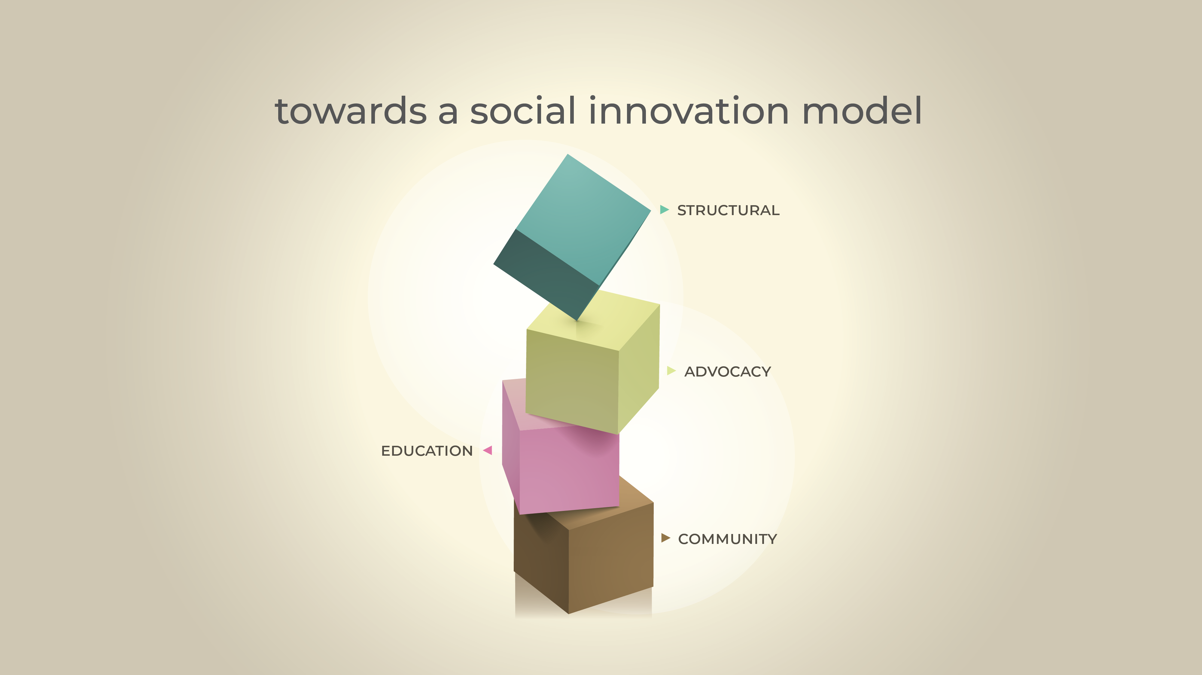
Notes:
Structural
Requires radical imagination that goes beyond the status quo and way things have always been done
As Amarillo College taught us, the structural change can begin in the classroom, at the departmental or faculty levels AND at the university wide level
The key is to not hide behind colonial capitalist bureaucracy
Change will require support across the university campus and with communities outside of academia
If this is to work, and create in the meantime and structural changes there needs to be political will along with radical imagination
I have tracked the lack of political will, for instance, in getting poverty discrimination in legislation at the federal level AND getting social class included in equity, diversity and inclusion mandates and policies. This needs to change if there is going to be structural change that addresses class-based education equity in Canadian universities
Accountability
It is through structural change and deep commitment that we we can hold institutions accountable for their status quo and harmful practices.
CLICK SLIDE

Slide 14
calls to action

Slide 15
Counter narratives (Ben Okri, Anastasia Christou)
Educate yourself
Advocate for poverty (social condition) legislation
Address poverty discrimination and class elitism in your department, faculty & institution
Contact Elaine

Slide 16
thank you
Dr. Budd L Hall
o-chair UNESCO chair in community based research and social responsibility in higher education
www.unescochair-cbrsr.org
@buddhall
Charity Slobod, MA
Community Connect Lead & Professional Development Coordinator, Faculty of Graduate Studies & Research
cslobod@ualberta.ca

Slide 17

We should talk
Elaine J Laberge PhD Candidate/ABD
elaberge@uvic.ca
www.echoesofpoverty.com

